Slide 1


Slide 2


Slide 3

storyline
reactions

Slide 4


Slide 5


Slide 6


Slide 7


Slide 8
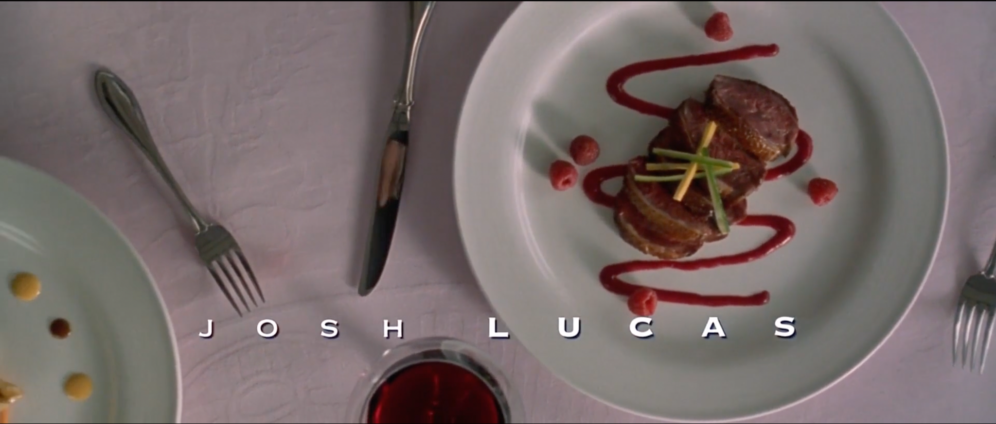

Slide 9
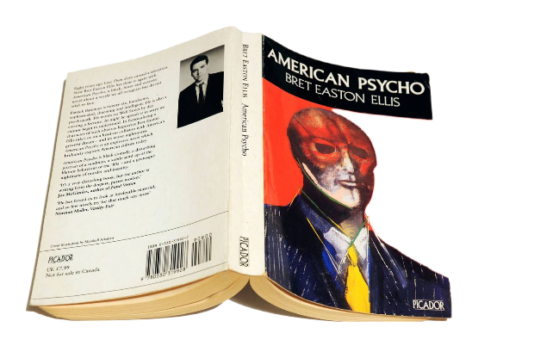

Slide 10
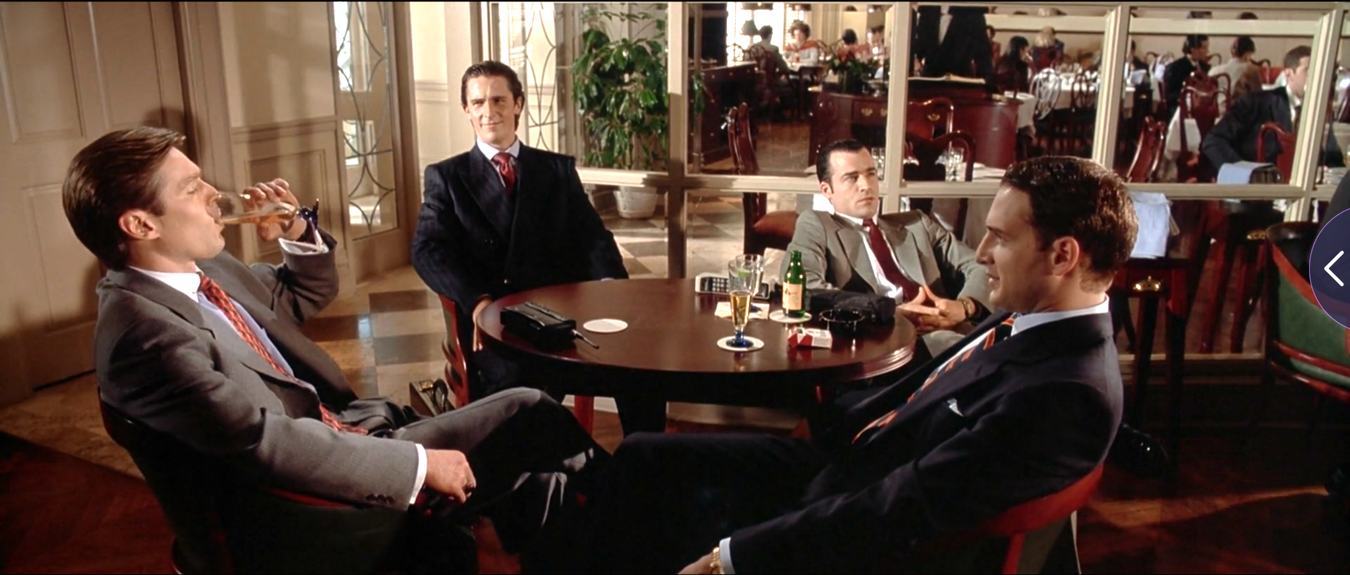

Slide 11
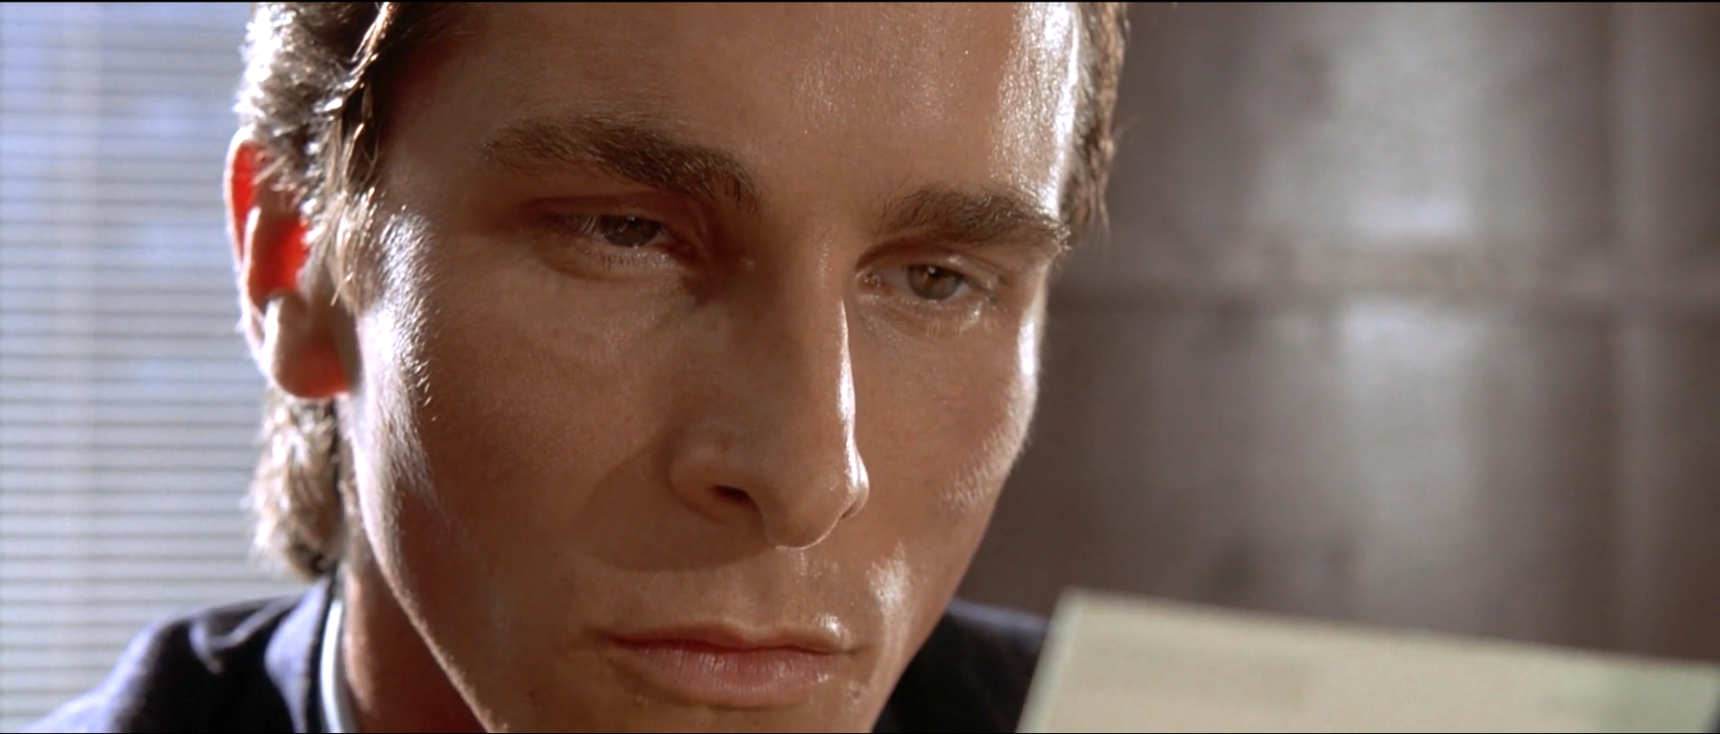

Slide 12
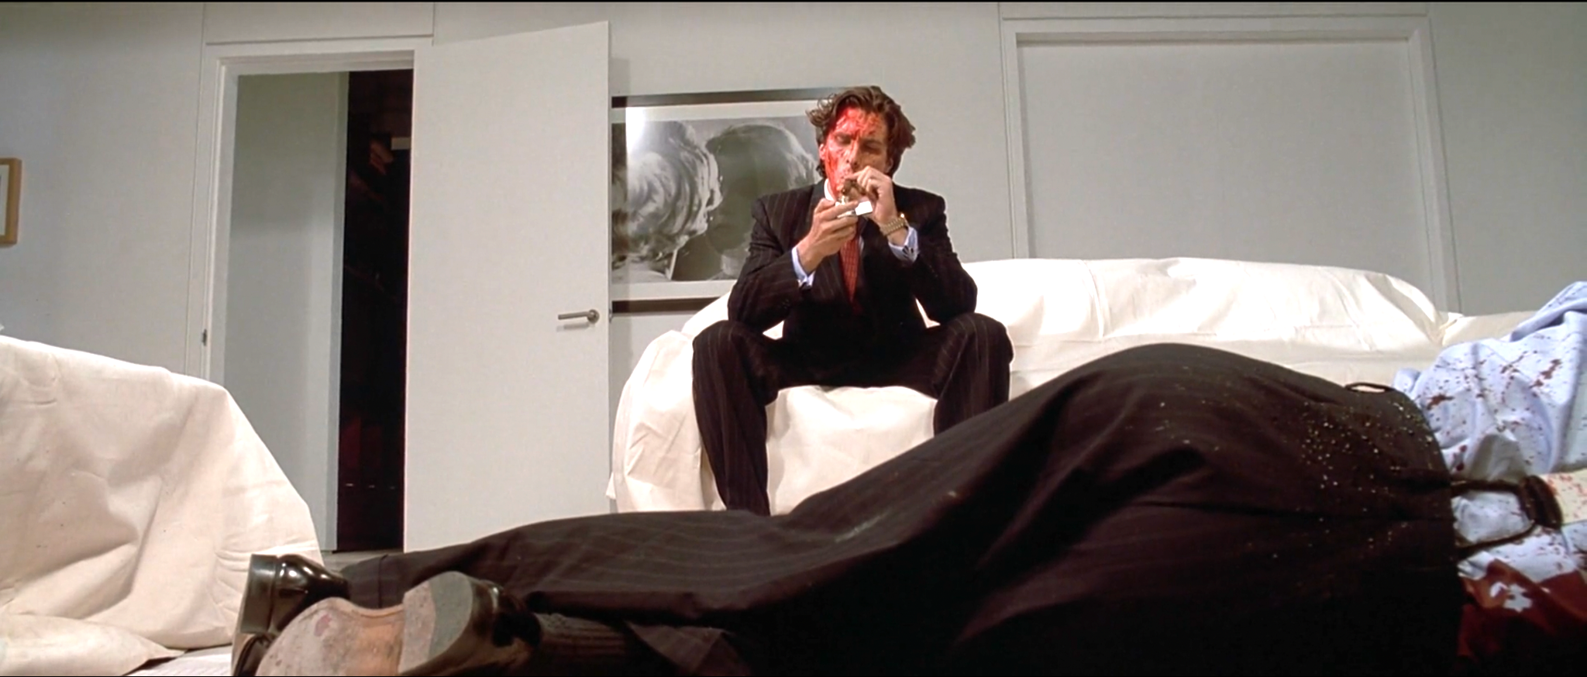

Slide 13
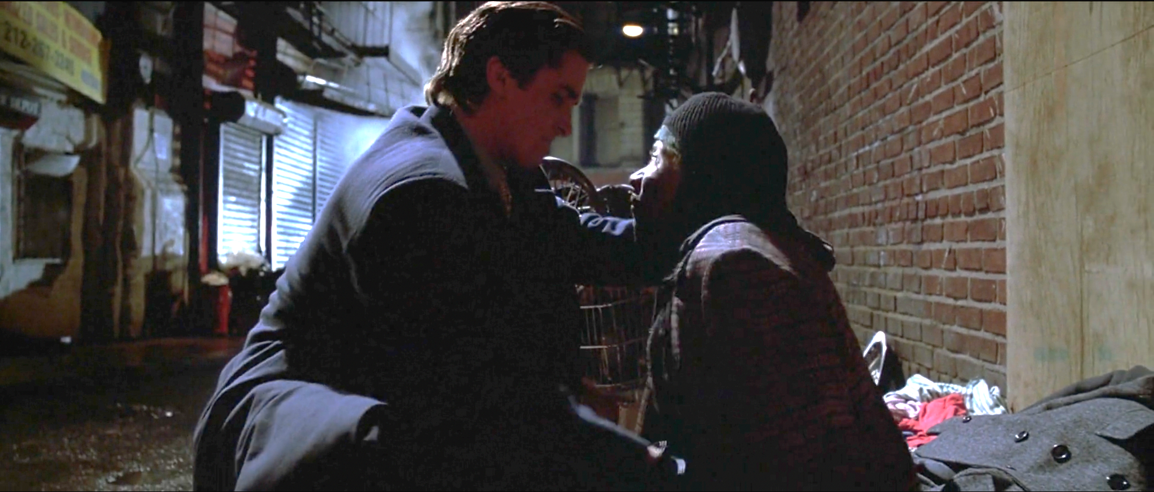

Slide 14
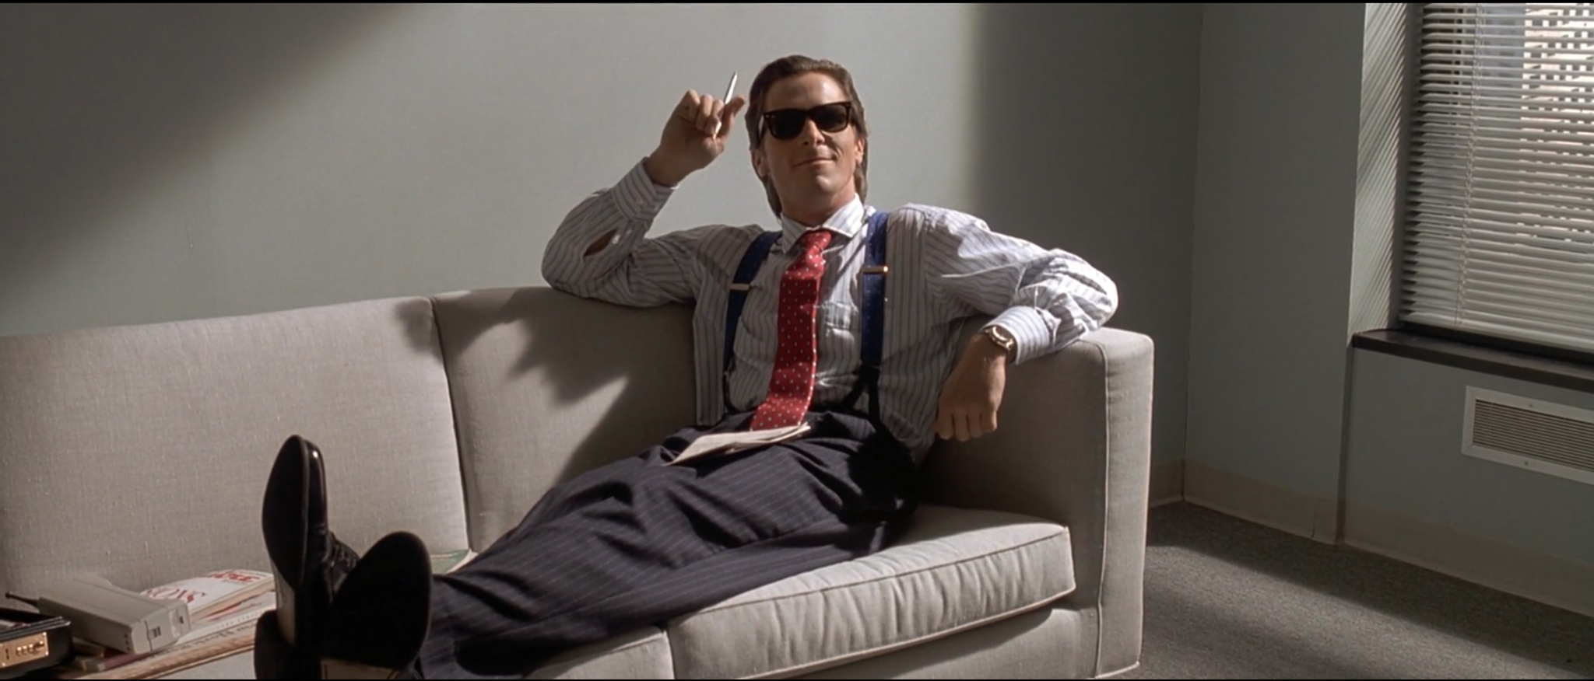

Slide 15
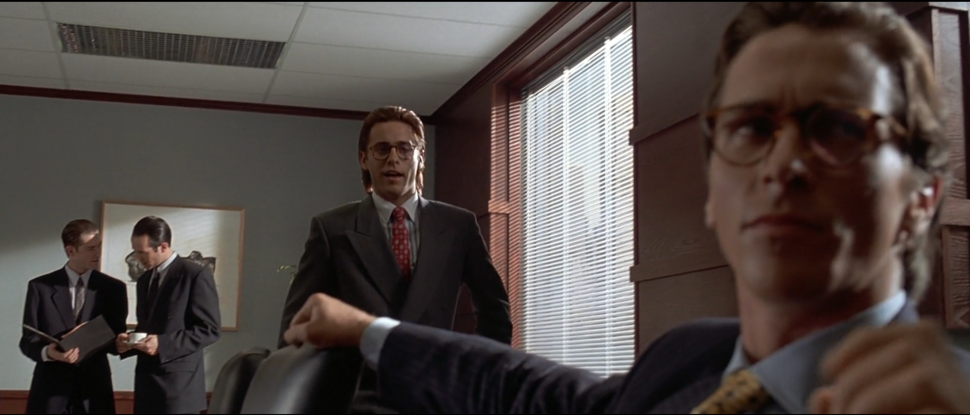

Slide 16


Slide 17
THANKS FOR YOUR ATTENTION :’)

Slide 18
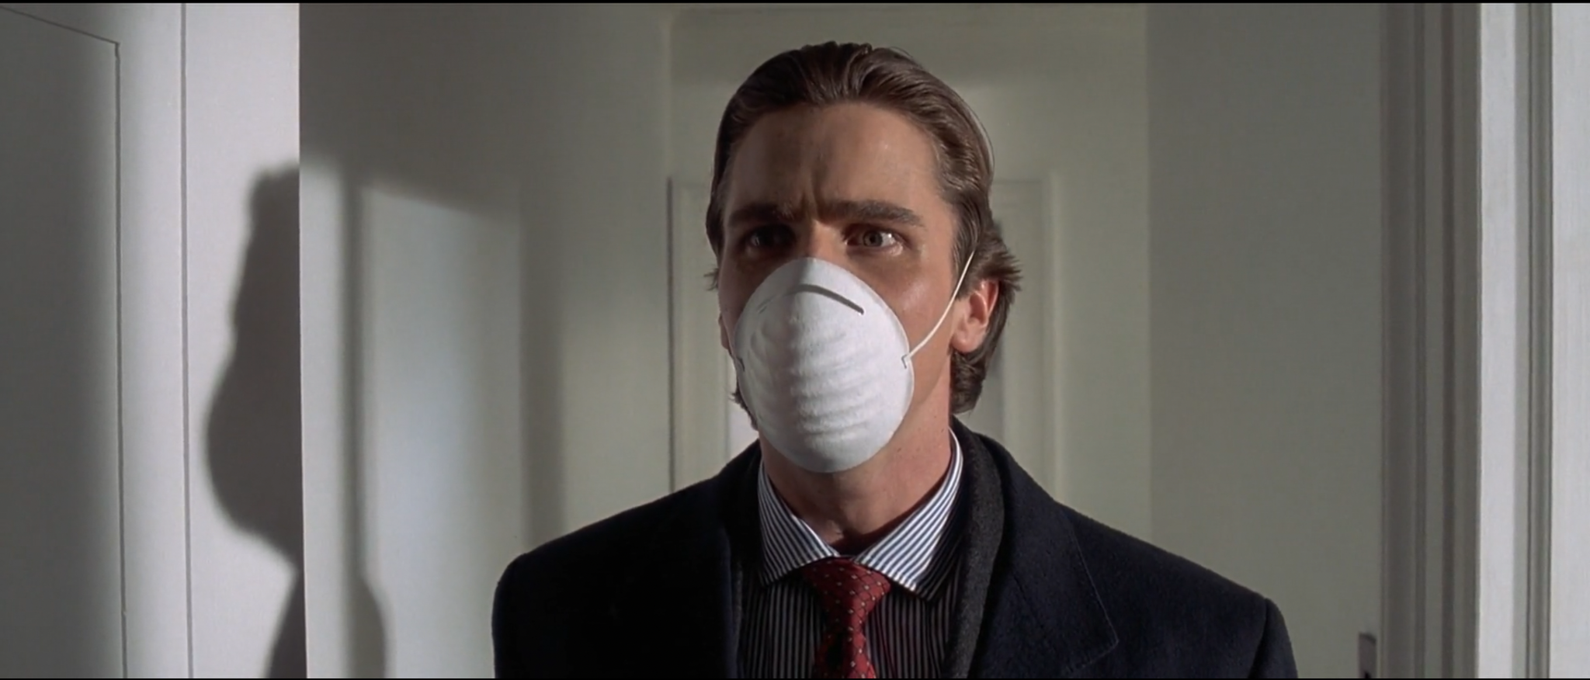


Slide 19
P L A C E - H O L D E R
Since Turnitin rejects presentations that not contain more than 20 words I need to add an extra page to satisfy this requirement. Then I’m adding below first two verses of Whenever,Wherever since I'm listening that now
Lucky you were born that far away so
We could both make fun of distance
Lucky that I love a foreign land for
The lucky fact of your existence
Baby, I would climb the Andes solely
To count the freckles on your body
Never could imagine there were only
Ten million ways to love somebody (body, body)

